Slide 1
CNN Based Federated Learning for Breast Cancer Diagnosis using Ultrasound Images
Group 41
Fatema Tuj Jahura (23366007)
Ripa Sarker(23366009)
Raisa Hasan Bushra(23366014)
Tasnim Fuyara Chhoan(23366035)
Course Instructor: Annajiat Alim Rasel
Mehnaz Ara Faizul (ST)
Humaion Kabir Mehedi (RA)

Slide 2
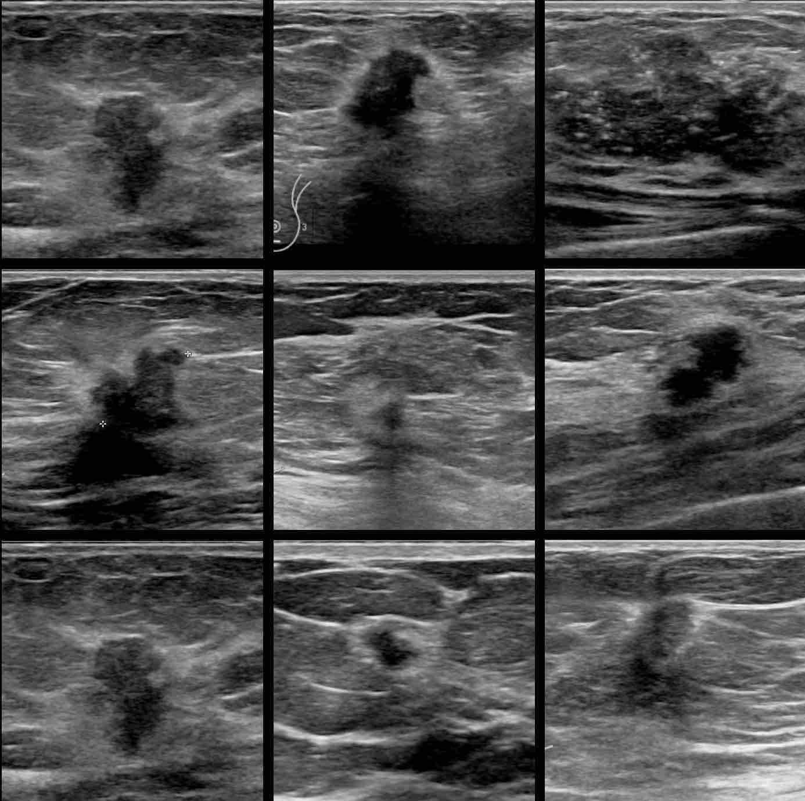
Table of content
Introduction
Literature Survey
Collected Data
Proposed Methodology
Limitation
Future Scope
Conclusion
Reference

Slide 3
Introduction
Problem Statement:
Illustration on breast cancer
Ways of detecting breast cancer
Risk of human error in manual diagnosis
Used Tools:
Federated Learning (FL)
Convolutional Neural Networks (CNN)
Integration of CNN-based federated learning for breast cancer diagnosis

Slide 4
Literature Survey
Developed Federated Learning infrastructure with Transfer Learning.
Collaborative Federated Learning for COVID-19 Screening.
Systematic Literature Review on FL in Medical Image Analysis.
Transfer Learning on Ultrasound Images for Breast Cancer Classification.
CNN-Based Breast Cancer Diagnosis with Large Dataset.

Slide 5
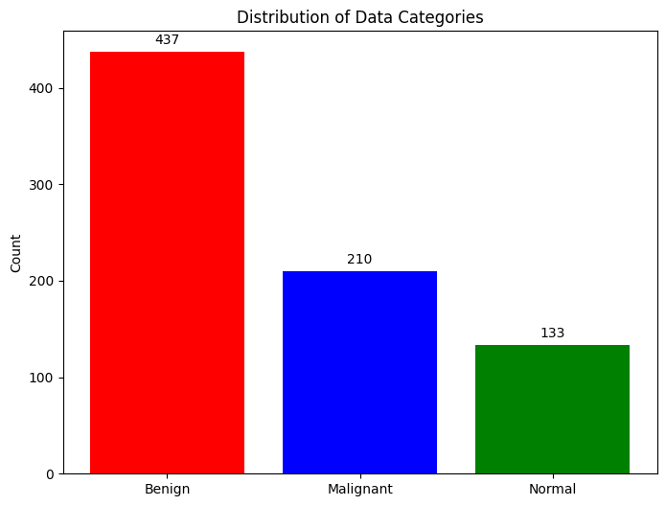
Collected Data
Breast Ultrasound Dataset Overview
Source: Kaggle
Year of Collection: 2018
Patients: 600 females
Total Images: 780 (PNG format)
Image Size: 500*500 pixels
Categories:
Normal (266 files)
Benign (891 files)
Malignant (421 files)
Ground Truth (GT): Ground Truth (GT) images are thoughtfully included, positioned at the bottom of each original image. This facilitates reference and serves as a crucial component for training and validation purposes.

Slide 6
Collected Data (Continued)
Significance:
Early detection crucial for reducing mortality
Great potential for classification, detection, and segmentation with machine learning
Valuable resource for developing models
Enhances accuracy and efficiency in breast cancer diagnosis

Slide 7
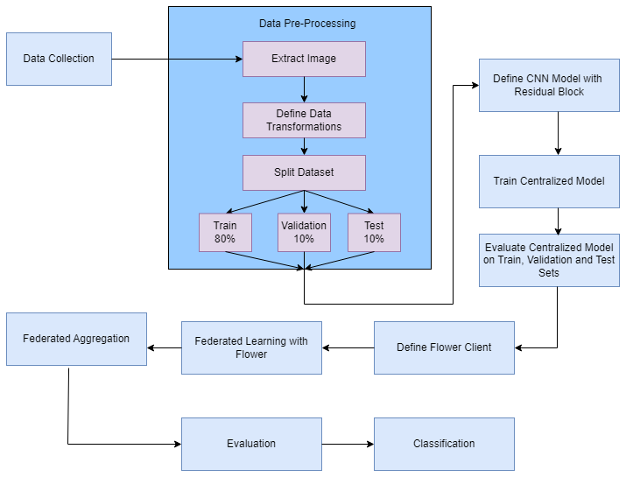
Proposed Methodology
Methodology employs a Kaggle dataset for centralized training with a custom CNN and extends to federated learning.The Proposed methodology involves :
Data Loading and Data Pre-processing
Define CNN Model with Residual Block
Centralized Training
Federated Learning
Evaluation & Visualization

Slide 8
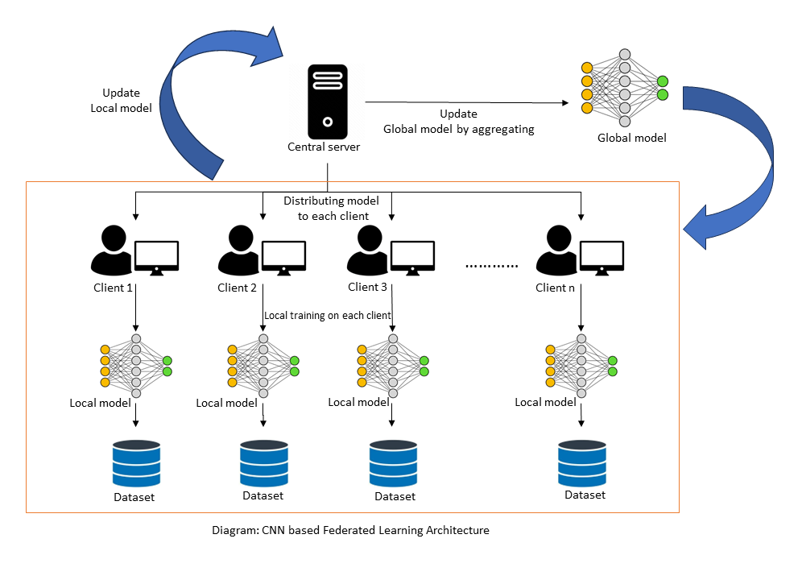
Proposed Methodology (Continued)
CNN Based Federated Learning Architecture
Key Components:
Centralized Model
Clients
Local Models
Local Data
Workflow:
Centralized Training
Model Distribution
Local Training
Model Update
Global Model Update
Iterative Process

Slide 9
Limitation
Future Scope
Dataset complexity
Class imbalance: unequal distribution of samples across different classes.
Higher resolutions capture more intricate patterns but require more computational resources.
Presence of multiple classes (3 class)
Lack of Computational resource
Can make more complex convolutional neural network (CNN)
Increase Network Depth and Width
Incorporate Different Convolutional Architecture
Spatial Pyramid Pooling (SPP) Layer
(We are working on improving)
Can use this model beyond breast cancer dataset in other healthcare sectors also beyond then that like in finance ,smart cities, manufacturing, telecommunication,in customer churn prediction, in agriculture, weather forecasting and so on.

Slide 10
Conclusion
The integration of CNN and Federated Learning (FL) for breast cancer detection using ultrasound images offers a promising solution to the challenges of centralized medical data. Leveraging the strengths of CNNs for intricate feature analysis and FL for collaborative learning from decentralized datasets, this approach aims to enhance diagnostic accuracy. Through meticulous dataset handling, model training, and result analysis, the combined model demonstrates potential for improved breast cancer diagnosis. The emphasis on large-scale deployment, integration with clinical workflows, and multi-model fusion underscores its practical applicability and holistic diagnostic capabilities.

Slide 11
References
[1] Katar, Oğuzhan Yildirim, Özal. (2023). Breast Cancer Segmentation from Ultrasound Images Using ResNext-based U-Net Model. Bitlis Eren Üniversitesi Fen Bilimleri Dergisi. 12. 10.17798/bitlisfen.1331310.
[2] KhoKhar, F. A., Shah, J. H., Khan, M. A., Sharif, M., Tariq, U., Kadry, S. (2022). A review on federated learning towards image processing. Computers and Electrical Engineering, 99, 107818.
[3] Hossain, M. A., Sajib, M. S. A. (2019). Classification of image using convolutional neural network (CNN). Global Journal of Computer Science and Technology, 19(2).

Slide 12
Thank You!

